Slide 1

NWAC
Sports Medicine Advisory Committee
Winter Protocols Update
1/14/2022
Updated 1/21/2022 (highlights)

Slide 2
Agenda
“Fully Vaccinated” Definitions
  NCAA Changes as of 1/14/2022 (Link)
Testing Procedures
Isolation and Quarantine
  NCAA Changes as of 1/14/2022 (Link)
Return to Play Protocol

Slide 3
Vaccination Status
Initially Vaccinated Individuals | Fully Vaccinated Up to Date | Fully Vaccinated, Not up to Date
Johnson & Johnson | Less than 2 months post vaccine, or with booster. | More than 2 months post vaccine.
Moderna | Less than 5* months post vaccine, or with booster. | More than 5* months post vaccine.
Pfizer-Biontech | Less than 5 months post vaccine, or with booster. | More than 5 months post vaccine.
Fully Vaccinated?
  New Definitions
    Fully Vaccinated, Up to Date
    Fully Vaccinated Not up to date
    Not Vaccinated
    Recently Infected.
Why these changes?
  Follow NCAA and NAIA Protocols
  Follow Fellow JuCo conferences
Why are there differences in the months of protection?
  Follows CDC guidance*
  Follows NCAA guidance*

Slide 4
Vaccination Status
Individuals who have a recent infection are granted full protections as if they were up to date of their vaccines.
Non-Vaccinated Individuals | “Immunized” or “Recently Infected” | Unvaccinated
 | Within 90 days post documented infection | All other times.

Slide 5
NCAA Changes this AM
Unvaccinated or not fully vaccinated:
  No COVID-19 infection within 90 days, and
  No vaccination with J&J vaccine, or
  No vaccination or only one dose of vaccination with mRNA Pfizer or Moderna vaccine, or
  Not having completed the primary series of a vaccine approved as part of the World Health Organization emergency use listing.
Fully vaccinated and booster eligible:
  No COVID-19 infection within 90 days; and
  More than two months since completion of the primary series of the J&J vaccine (one dose), or
  More than five months since completion of the primary series of the mRNA Pfizer or Moderna vaccine (two doses);
  More than recommended time since completion of the primary series of a vaccine approved as part of the WHO emergency use listing; and
  No booster vaccine.
3. Fully vaccinated and up-to-date:
  Within 90 days of documented COVID-19 infection, or
  Within two months of having completed the primary series of the J&J vaccine (one dose), or
  Within five months of having completed the primary series of the mRNA Pfizer or Moderna vaccine (two doses), or
  Within the recommended time since completion of the primary series of a vaccine approved as part of the WHO emergency use listing, or
  Following a booster vaccine for those who are beyond two months of the J&J vaccine, beyond five months of the mRNA Pfizer or Moderna vaccine, or beyond the time for a WHO emergency use listing vaccine.

Slide 6
NCAA Summarization
Category | Definition
Not Vaccinated | If you have never received or are incomplete with your initial series
Fully Vaccinated, Booster Eligible, “Not up to date” | If you completed your initial series but have not received the booster dose. You are in this category if your vaccination was greater than 5 months with Pfizer & Moderna -OR- 2 months with Johnson & Johnson (J&J)
Fully Vaccinated, Boosted, “Up To Date” | You are fully vaccinated if you have completed your initial series and are not yet eligible for the booster -OR- You have completed your booster.
Recently Infected? | Must have a confirmed diagnosis of COVD-19 with a positive test result. The date of the test is the confirmed date.

Slide 7
Vaccination Status
These changes go in effect on
January 24th, 2022
To allow student athletes who are initially vaccinated, but not protected to find a booster if they choose to become up-to-date

Slide 8
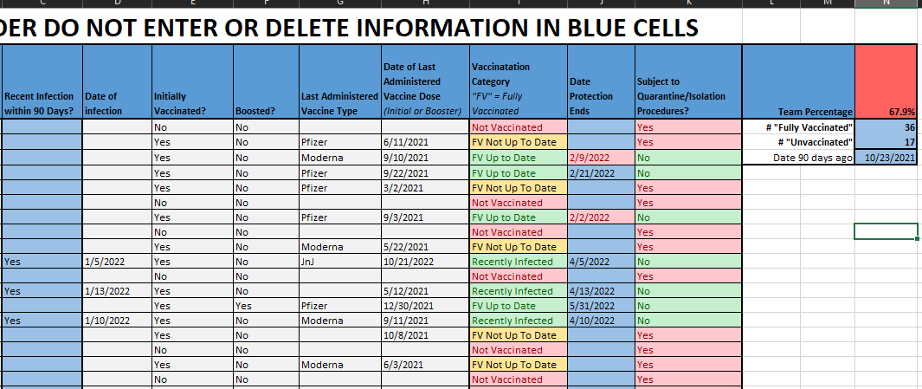
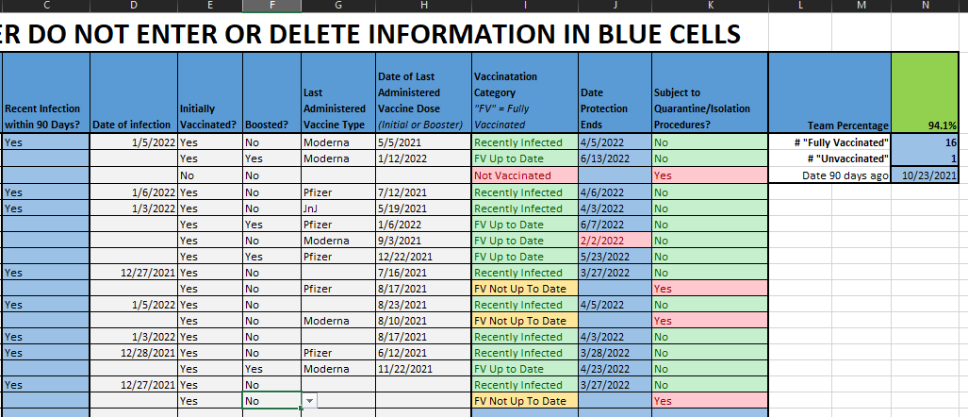
Tracking Vaccination Status
An Excel Calculator has been created to assist with tracking, (in 3rd version development)

Slide 9

Questions Thus Far?

Slide 10
Testing Protocol Review
Circumstance | Fully Vaccinated Up to Date Fully Vaccinated Not up to Date Recently Infected | Unvaccinated or not complete with vaccination series
Return to Campus (Personal Travel) Return from break | Prior to arrival, 3-5 days before; must have 1 Negative PCR Or Negative rapid antigen on arrival
During Competition Season | Not tested unless Close Contact Symptomatic | During a week with no competition: Weekly PCR testing or 2x/wk antigen testing. During a week with competition: PCR within 72 hours Antigen test <24 hours of each competition Continue 2x/wk of antigen testing if less than 2 competitions.
Post Exposure/Close Contact | Tested on Day 5 | Quarantined until day 5, Tested on Day 6.

Slide 11
Testing Protocol Review
Circumstance | Fully Vaccinated Up to Date Fully Vaccinated Not up to Date Recently Infected | Unvaccinated or not complete with vaccination series
Surveillance Testing | Not tested unless Close Contact Symptomatic | Weekly PCR testing or 2x/wk antigen testing. This applies to teams practicing indoors that are not specifically “winter” sports; including spring and fall sports.
Sustained Transmission | Sustained increased transmission is likely occurring if: • Team of < 50: Concurrent positive cases of three or more. • Team of > 50: Concurrent positive cases of 5 percent or more. When sustained increased transmission is occurring, decisions about continued team activity should be made at the local level and with consideration given to ongoing risk of team transmission or transmission to another team during competition.

Slide 12
Questions Thus Far?

Slide 13
Quarantine and Isolation
Those considered fully vaccinated or recently inoculated do not need to enter quarantine or isolation unless symptomatic and positive
Those that are unvaccinated or not up to date with their boosters are subject to quarantine and isolation protocols.

Slide 14
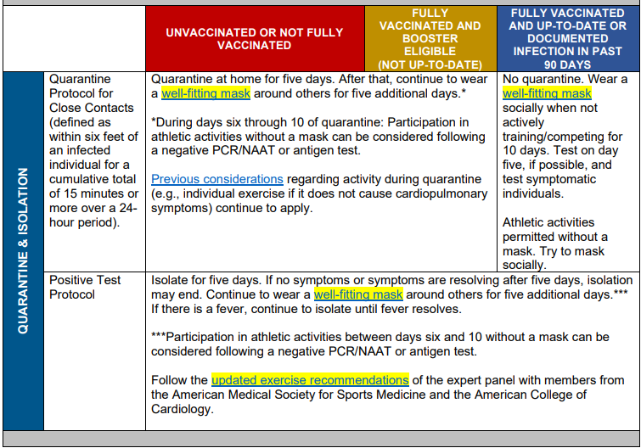
NCAA Changes
These follow our previous language without any changes.

Slide 15
Positive Isolation & Return to Play Update
Follows CDC Guidelines
5 Day Isolation
  Day of symptoms or test date (whichever comes first) is Day 0
  5 Days of Isolation
  Day 6 if symptom free for previous 24 hours, they may be released from isolation
  Day 6 A Negative Rapid Test is required to begin return to play protocol.

Slide 16
Exposure Guidelines Update
Following an exposure to a positive individual for those who are unvaccinated or no longer protected by their initial vaccinations;
5 Day Quarantine
  Day of symptoms or test date (whichever comes first) is Day 0
  5 Days of Isolation
  Day 6 if symptom free for previous 24 hours, they may be released from isolation
  Day 6 A Negative Rapid Test is required to return to athletics.
    Caution must be applied to prevent musculoskeletal injury, individuals coming directly from quarantine cannot go into a game on day 6.

Slide 17
Quarantine Day Review
The day that the individual is found to be
  Positive
  Symptomatic, or
  Exposed
is considered day,
0

Slide 18
Questions Thus Far?

Slide 19
Return to Play after Positive Test Update
Return to play based on symptomology and current best practice.
Asymptomatic or mild cases may go through an abbreviated 3-day return (full clear day 4) if
  24hrs symptom free from day 5-6
  Negative Rapid Antigen Test.
Additionally, an option to return one day sooner is possible if physician can clear athlete to return to play. (2-day return, full clear day 3)
The next slide details symptomology chart.

Slide 20
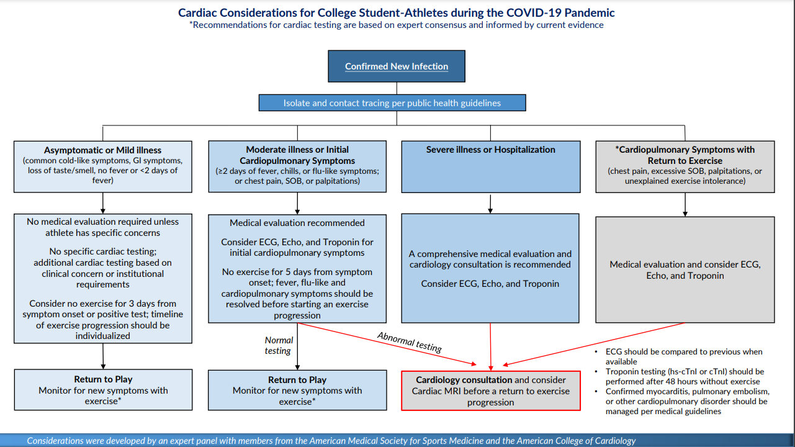
SOB = Shortness of Breath

Slide 21
Return to Sport Post Covid Protocol
Asymptomatic or Very Mild Cases with symptoms lasting less than 4 days
Completed Isolation (Day 6)
Symptom Free for Past 24hrs (Day 5-6)
Negative Rapid Antigen (Day 6)
Physician Clearance on Day 6
2 Days Gradual
Return to Sport Day 3
No Physician, Graduated Return
3 Days Gradual
Return to Sport Day 4

Slide 22
Return to Sport Post Covid Protocol
Asymptomatic or Very Mild Cases with symptoms lasting less than 4 days
Positive antigen on day 6 requires continued isolation until negative test is documented.
Completed Isolation (Day 6)
Symptom Free for Past 24hrs (Day 5-6)
Positive Rapid Antigen (Day 6)
Physician Clearance after isolation ends
2 Days Gradual
Return to Sport Day 3
No Physician, Graduated Return
3 Days Gradual
Return to Sport Day 4
Continue Isolation until negative test
(day 6-X)

Slide 23
Return to Sport Post Covid Protocol
Mild Cases with symptoms lasting more than 5 days
Moderate or Severe cases.
Symptom severity is
moderate or severe
Mild but longer than 5 Days
Physician Clearance Needed before
Return to Sport Protocol Begins
Moderate : Physician Oversight
Mild case greater 5 Days
Physician guided
4 Day Gradual, 5th day clear
Severe : Physician Oversight
Day x+1: 30-minute practice
Day x+2: 45-minute practice
Day x+3: 60-minute practice
Day x+4: Full Practice
Day x+5: Released for games.

Slide 24
Return to Play Basic Decision Tree
Day 5
Day 6
Days 7-10
Completed Full
5-day Isolation
24hrs Symptom Free
Negative Rapid Test
Positive Rapid Test
Still Symptomatic
Remain in Isolation until Symptom Free
Graduated Return to Play
Additional 5 days of Isolation
If over 5 days then physician approval needed
Graduated Return to play
Graduated Return to Play

Slide 25
Common return to play test questions
Why are we testing on Day 6 after isolation?
You can test positive for up to 90 days!
It depends
Our protocols use a specific test for specific reasons; Here’s why,

Slide 26
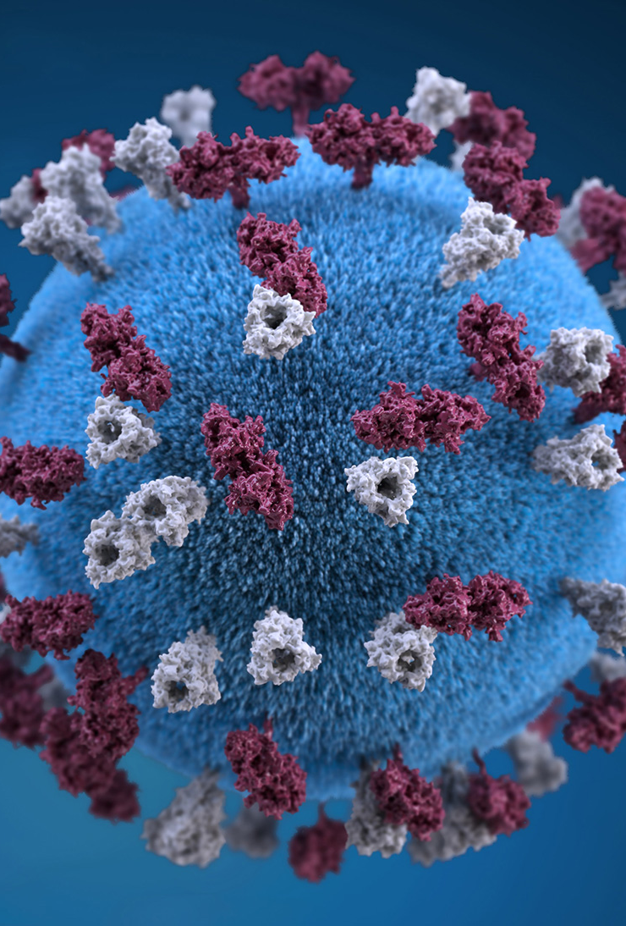
Infectious period is longer than CDC says
With the recent guidance from the CDC, it’s important to know that data shows that;^{1,2}
  On, AVERAGE the infectious period is
Infectiousness can be more prolonged in more severe cases.
Yes, the CDC says slightly different timelines in their official statements, but this is what the research supports when you read the studies.
  Preliminary data from the UK also shows that up to 16% of people if released on day 6 will still be infectious.³
2-3 Days
BEFORE &
symptom onset
8 Days
AFTER
symptom onset
This Photo by Unknown Author is licensed under CC BY-NC-ND

Slide 27
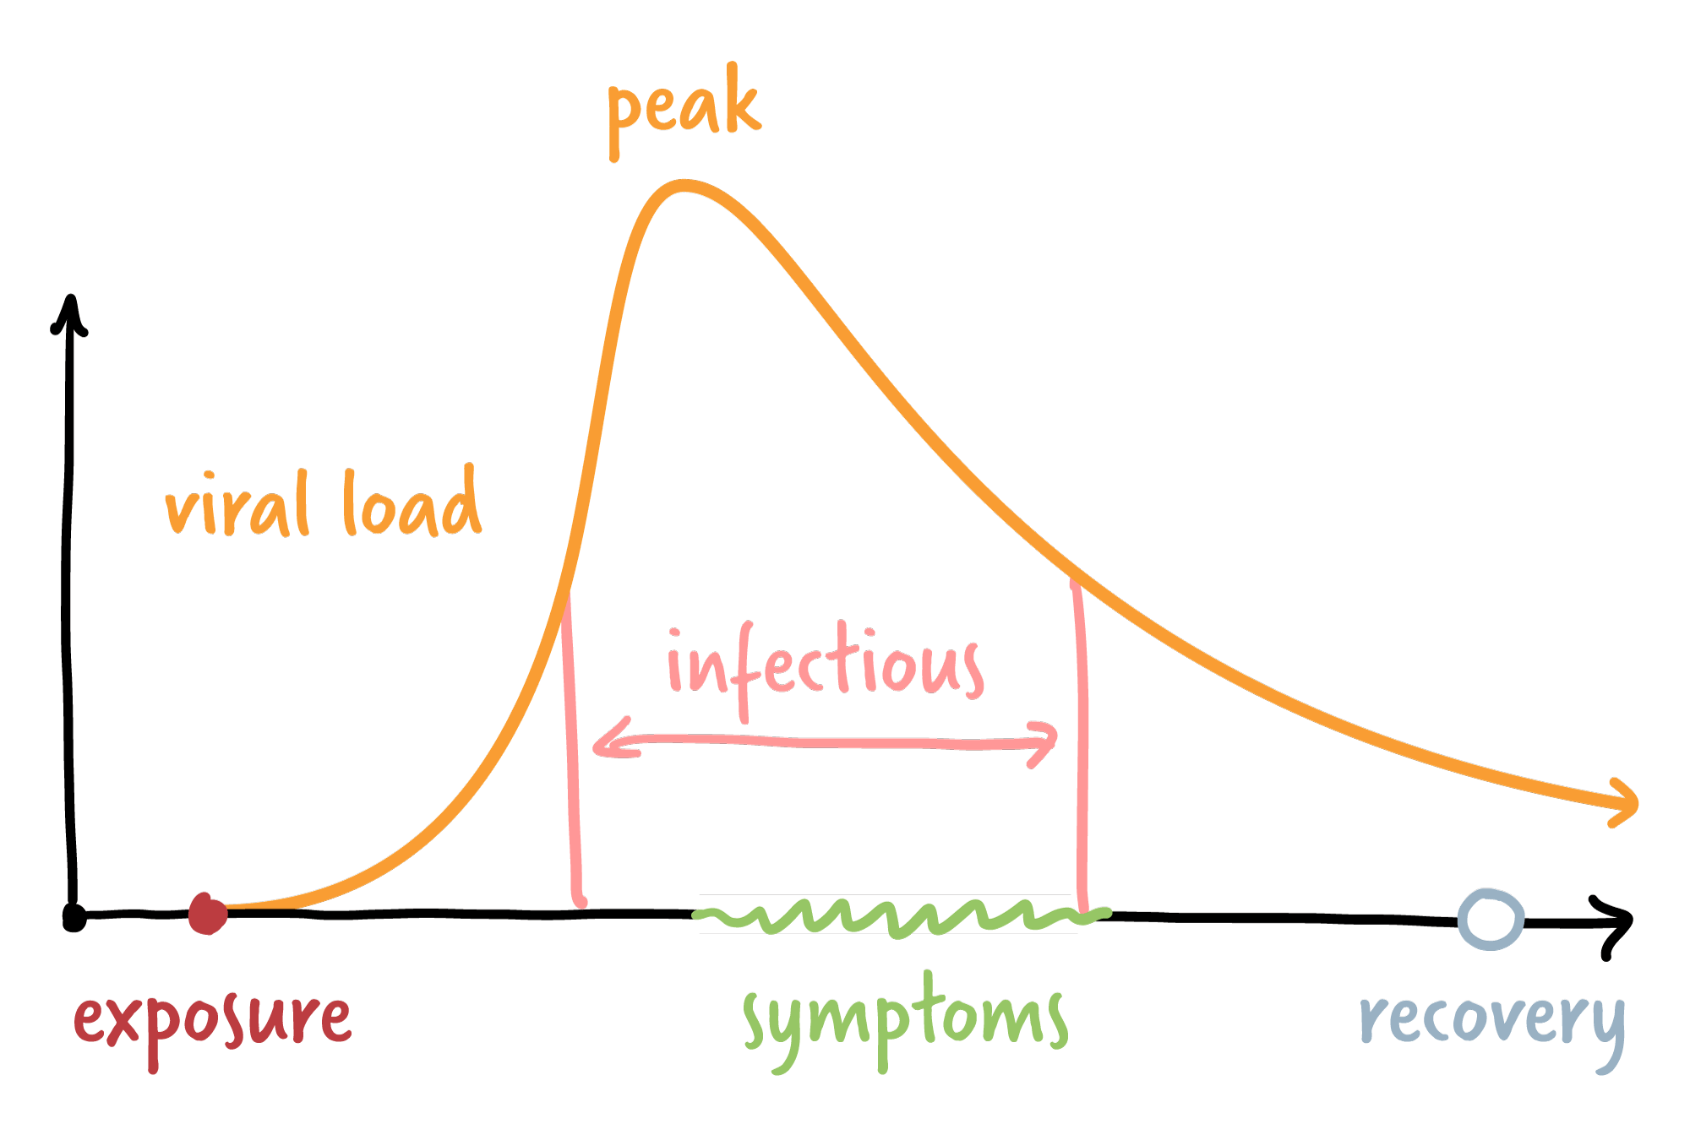

Infectious Period
With updated CDC guidance, there’s a chance that individuals are still infectious after their 5-day isolation.
As a result, we are asking you to test on day 6 with a Rapid Antigen Test to identify if athletes are still infectious.
Sidenote: Catching people here is the purpose of surveillance testing
2-3 days
Up to 8 days

Slide 28
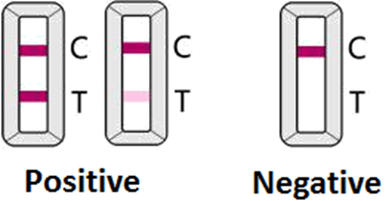
But won’t that test be positive?
Only if they have enough viral load to be considered infectious
Let’s explore why that may be

Slide 29
Rapid Antigen works differently than PCR
Rapid Antigen
Utilizes available antigen (or protein) to create a chemical reaction on a test strip.
Enough viral antigen must be carried across the threshold to be considered positive.
  Can lead to false negatives if tested too early after exposure.
Polymerase Chain Reaction (PCR)
Utilizes a cycling process to amplify available DNA to identify the presence of a specific genetic material.
  A single stand of Covid-19 will be replicated to over 1 trillion copies within 40 cycles

Slide 30
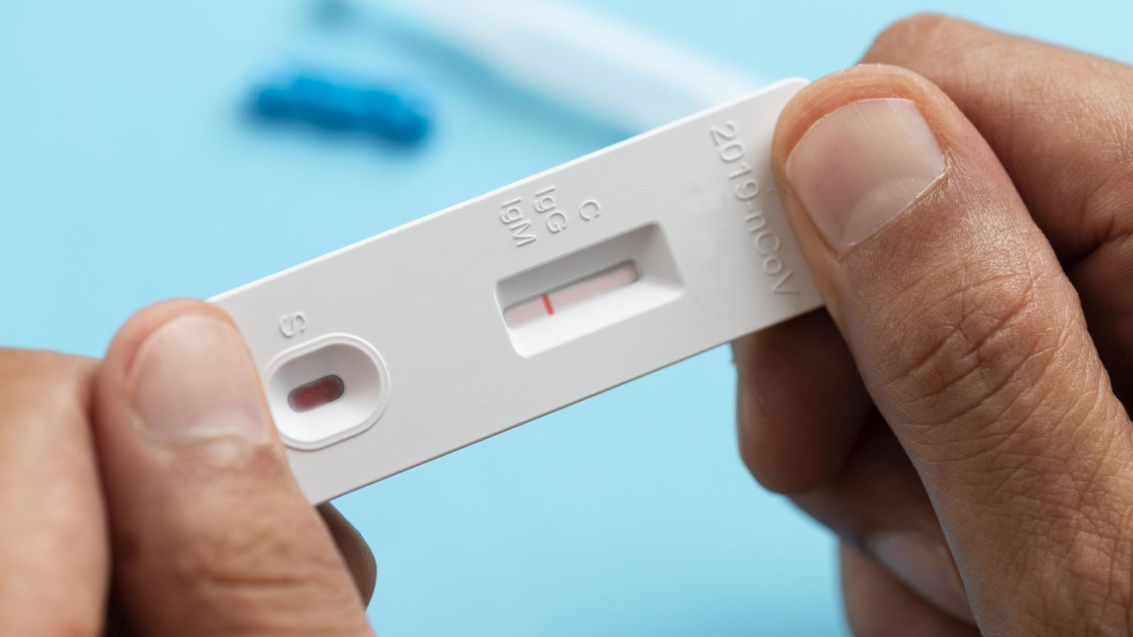


How a lateral flow assay works (Rapid Antigen)
-
TEST
CONTROL
RESULT
No Antigen
Some Antigen
Lots of Antigen
The Sample swab is put into a buffer solution
As sample passes through the strip, a reagent is added to the solution
The solution travels up the strip with reagent or antigen-bound reagent
This part of the strip contains antibodies that bind to the antigen, causing the antigen to stop flowing up the strip.
Because the antigen is bound with the reagent, the buildup of the reagent causes the color to change.
This line turns from Blue to Pink as a reaction with the buffer solution to indicate that the test has worked.
The reagent not bound to any antigen turns the line from pink to blue.

Slide 31
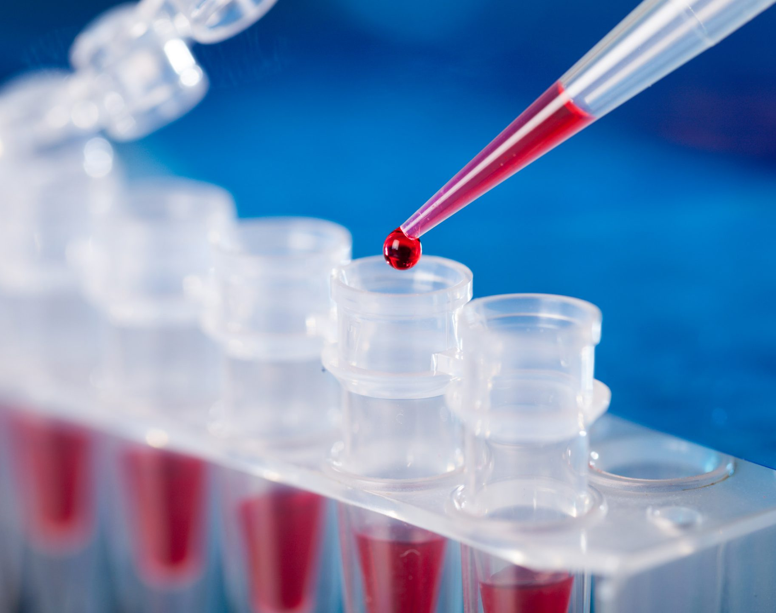
How PCR Works
Start
Cycle 1
Cycle 1
Cycle 5
Cycle 2
Cycle 2
Cycle 3
Cycle 3
Cycle 4
Cycle 5
Cycle 4
Starting with a swab sample, it’s placed into an analyzer that amplifies the genetic material and replicates copies of the sample. This doubles the amount of genetic material each cycle.
Normally 40 cycles are completed of amplification and replication.
Using a PCR test on day 6 will always be positive, and furthermore, using a PCR for up to 90 days may also produce a positive. This is why many recommendations came out to say not to test.
Our protocols require the use of Rapid Antigen for this reason.

Slide 32
In conclusion
The rapid antigen test on day 6 is utilized to identify if people are still infectious based on the viral load present on day 6.
The relative probability that this is positive is low,³ but the test is still sensitive enough to identify those still infectious.
If positive, they are to finish their 10-day isolation. This is to ensure that they are no longer infectious.
A test is not needed on day 11 unless required or recommended by your local health authority.

